Slide 1



Django Project Demo
FS’tival-22 Software Freedom Day

Slide 2
Problem Statement
For a Restaurant, Restaurant owner finds it difficult to update their physical menu card frequently whenever there is a requirement of updation in the Menu. They have to print a new Menu card whenever they would like update the price of any dish or add new dishes to the menu.Also,sometimes, Customers visiting the restaurant find it difficult to have access to the menu card.

Slide 3
Objective
To solve this problem, We have built a Website that would enable Restaurant owners to add and update their the details of already existing items through the website. Also, the customers could view the E-Menu card using a QR code that would be physically present in the restaurant.

Slide 4
Tech Stack
FRONT END
HTML
CSS
JAVASCRIPT
BACK END
DJANGO
POSTGRESQL

Slide 5
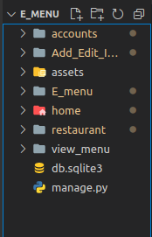
Modules
Modules Used :
Home
Accounts
Restaurant
Add_Edit Items

Slide 6
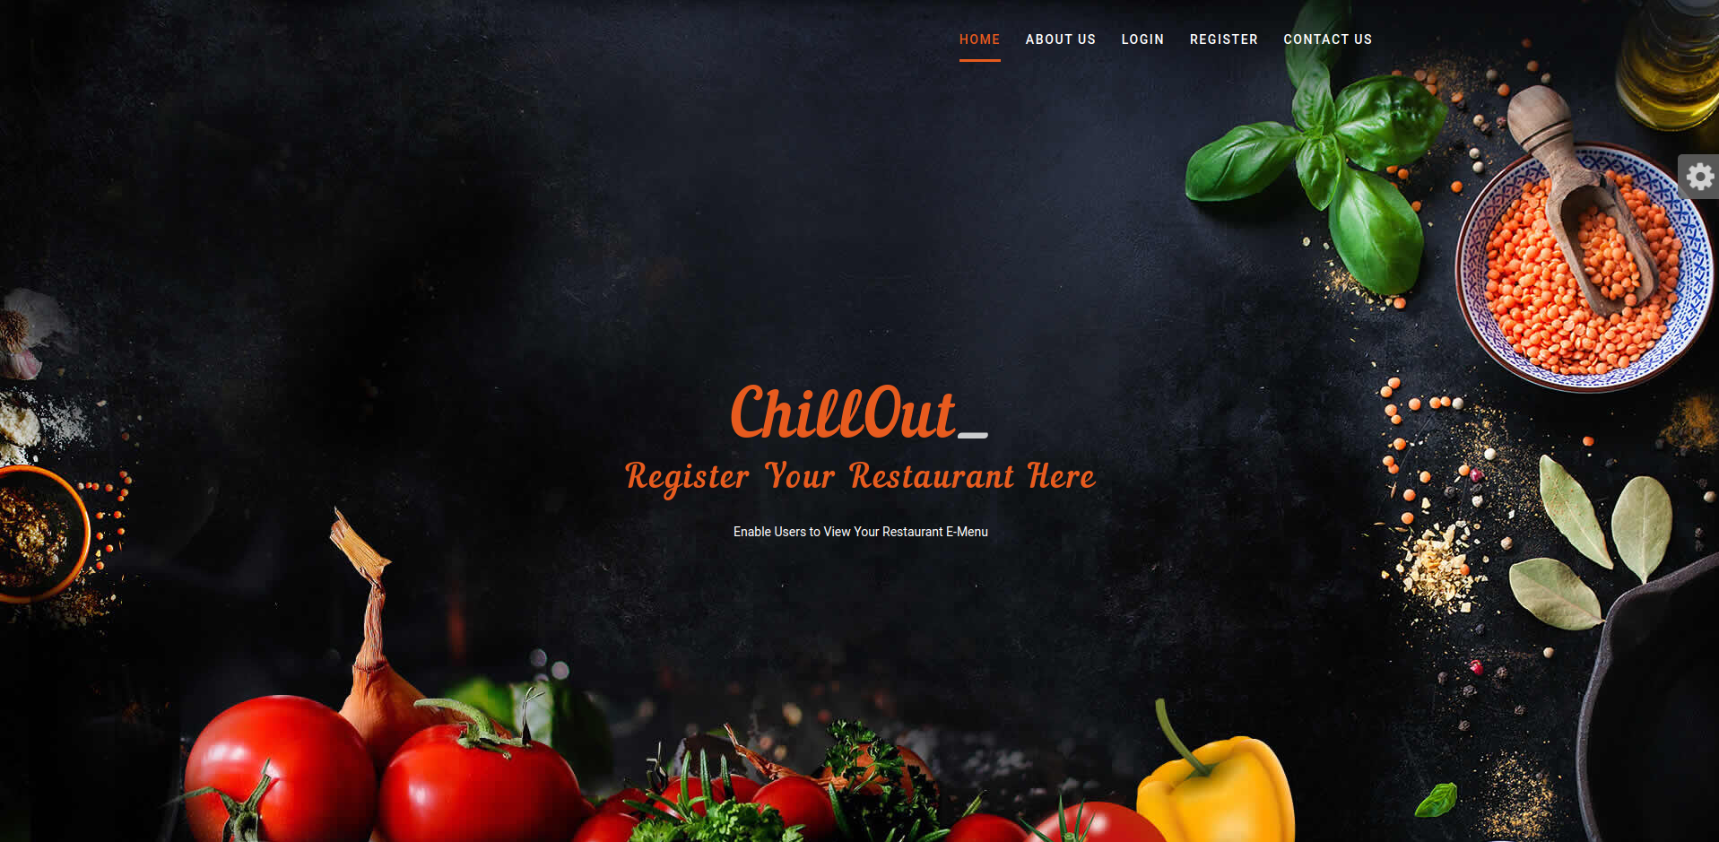
HOME

Slide 7
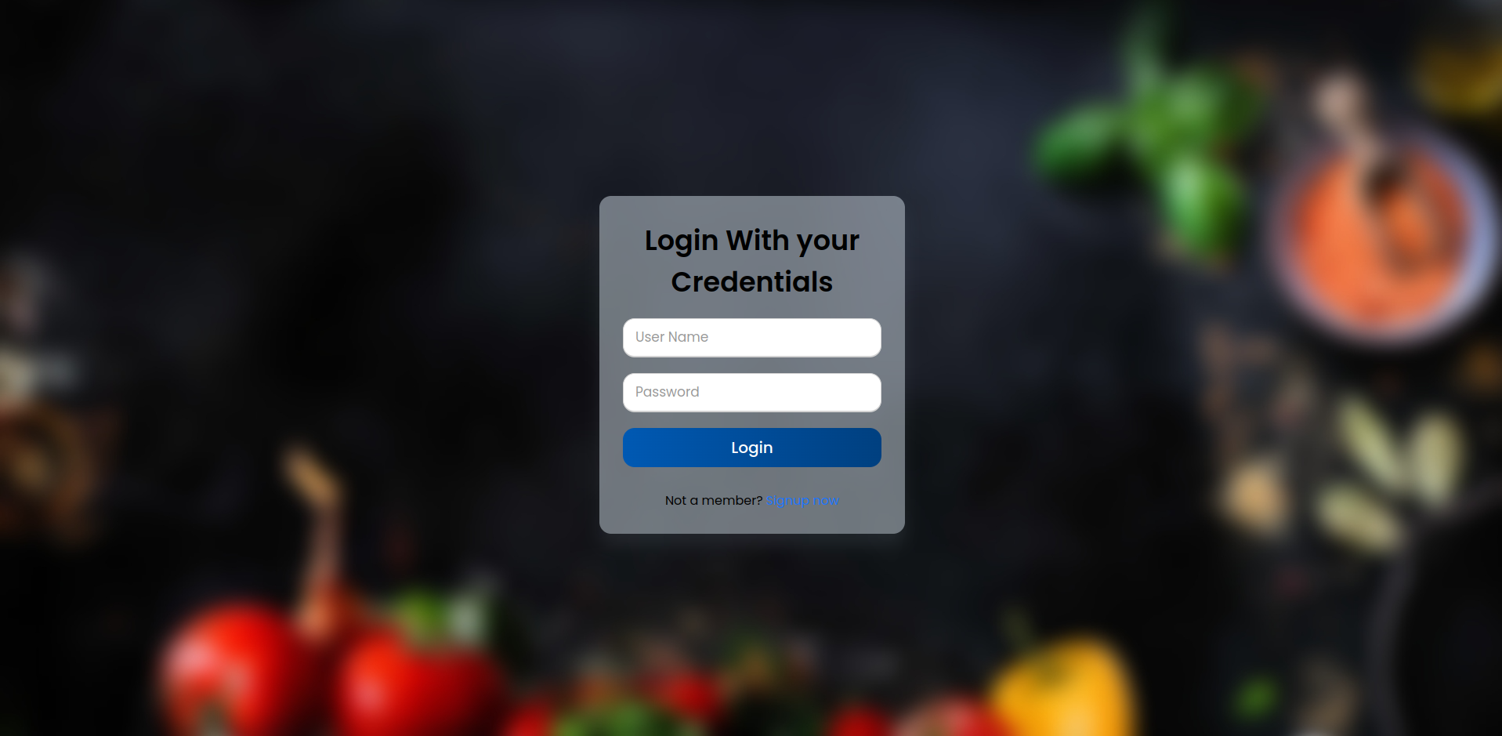
ACCOUNTS (LOGIN)

Slide 8
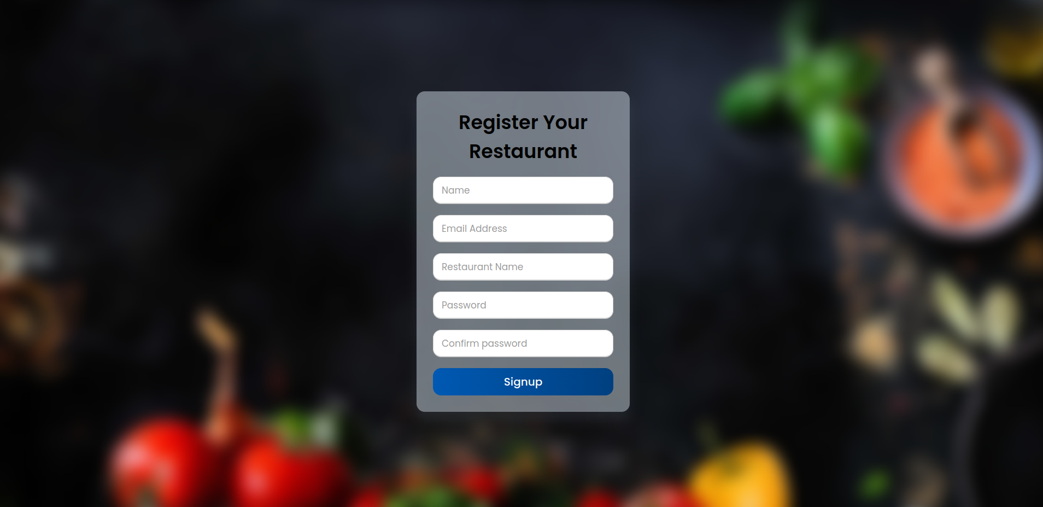
ACCOUNTS (REGISTRATION)

Slide 9
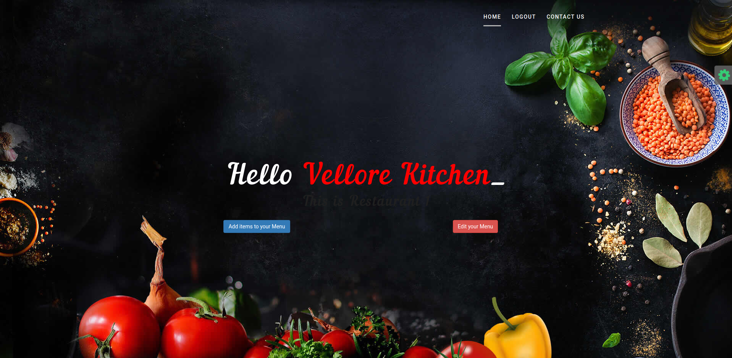
RESTAURANT

Slide 10
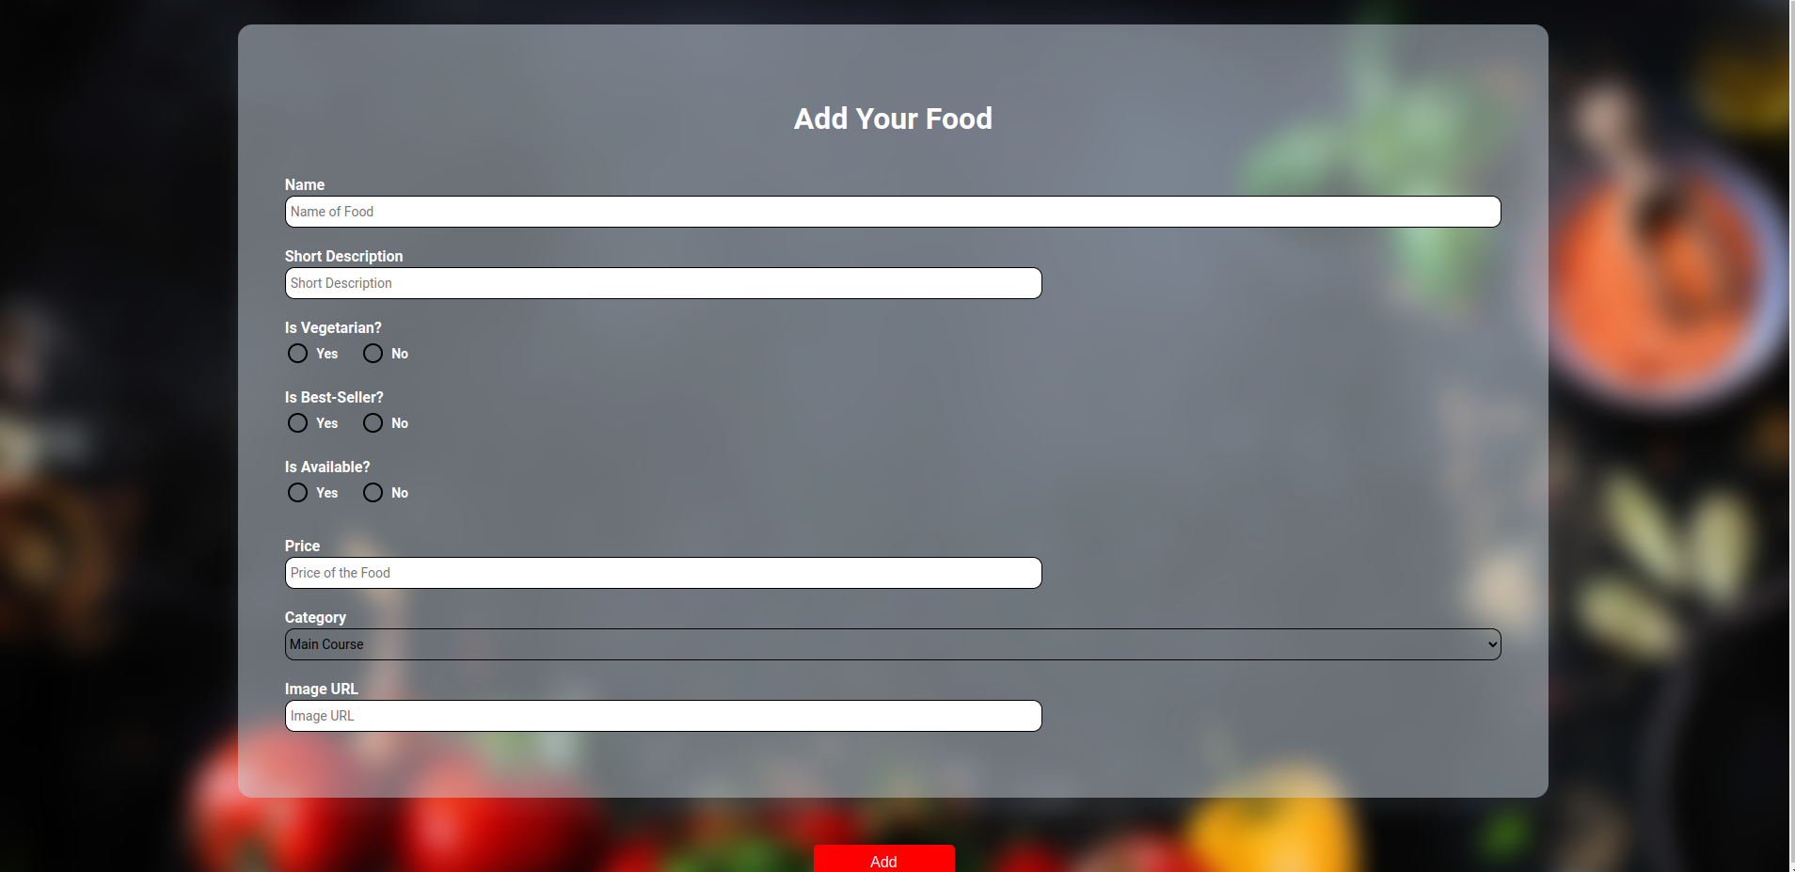
ADD ITEMS

Slide 11
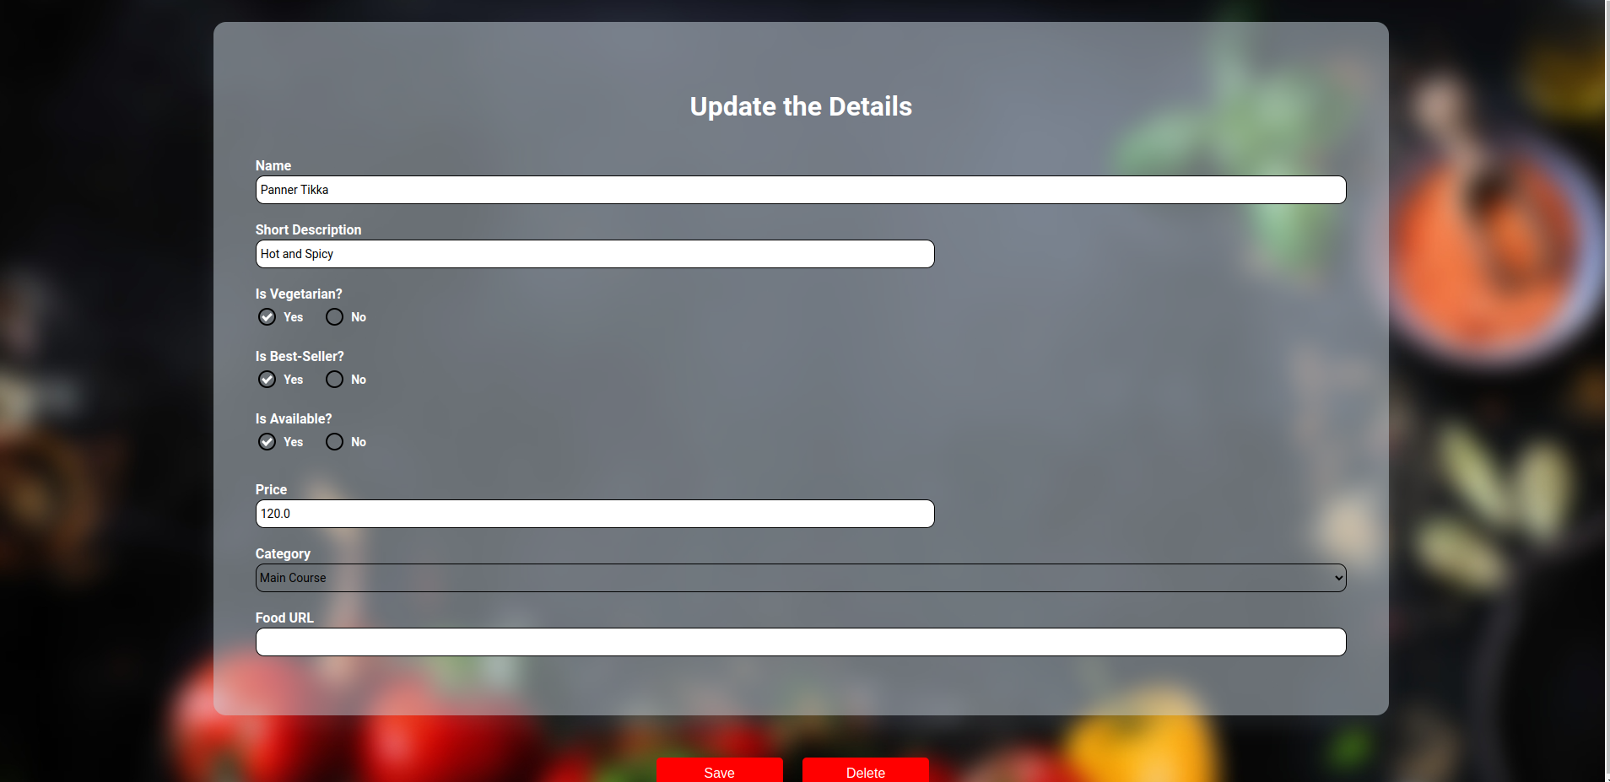
UPDATION

Slide 12
Thank You

